Slide 1


Knowledge Graph
WIKI

Slide 2
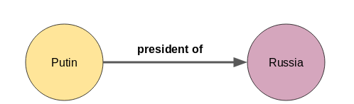
Approch
Understanding Graph knowledge?
The first step in building a knowledge graph is to split the text document or article into sentences,
Extract Entities,
Extract relations
Persist Knowledge Graph in DB
The right way to Extract the entities and relations is thru Natural Language processing
What NLP was considered ?
Stanford
Princeton
Why Natural?
https://www.npmjs.com/package/natural#pos-tagger – supports Princeton NLP
Its one of the Best Natural Language Processing framework for Node.js
Sample from my code logs NLP changing sentence into meaningful POS( verb,noun,adjective,prepostitions)
{ token: 'Madagascar', tag: 'NNP' },
{ token: 'has', tag: 'VBZ' },
{ token: 'diplomatic', tag: 'JJ' },
{ token: 'relations', tag: 'NNS' },
{ token: 'with', tag: 'IN' },
{ token: 'many', tag: 'JJ' },
{ token: 'countries', tag: 'NNS' },
{ token: 'both', tag: 'N' },
{ token: 'individual', tag: 'JJ' },
{ token: 'bilateral', tag: 'JJ' },

Slide 3
DB Choice
Why GraphDB?
Graph Knowledge requires Many to Many –mapping which cannot be accomplished by sql(mysql/postgres) or nosql(Mongodb,cassandra)
so for this use case we need graphdb or Neo4j
Why Neo4j?
Number one graph dbms
More supported languages
It support trigger which could be useful for future use case

Slide 4
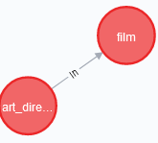
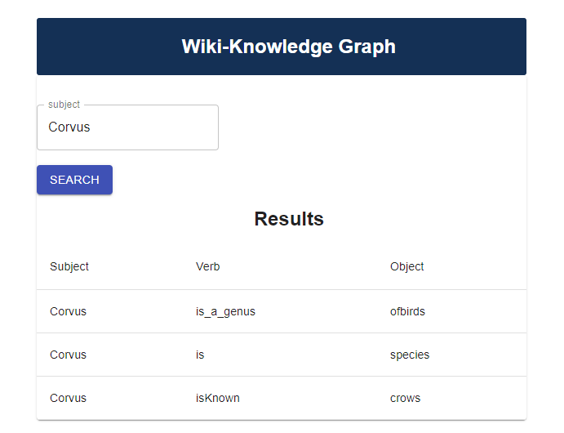
Architecture
uploadBatch
Parser/scrapper
Node.js ParseXML
Ref:Demo3-Upload and XML covertion vidoe
Converts xml stream to json and send it to NLP
NLP
Node.js(Priceton university NLP)
Eric Brill's transformational algorithm /natural
API for Inserting/Merging Node and Relation in DB
Neo4j:Graph
React.js UI
Node API to Fetch data and Message it for UI req ( Noun-verb-noun) or ( noun-verb-adjectives) (API)
API for reading Data for UI Search

Slide 5
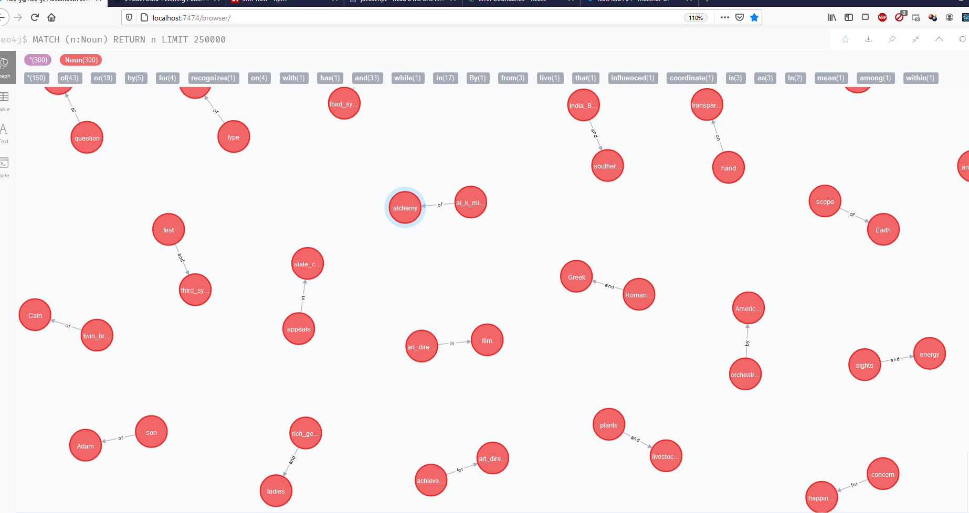
Data Stream and uploaded in Neo4j

Slide 6
